Slide 1
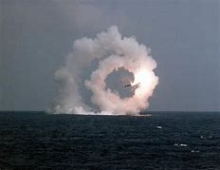
Aerodynamic Stability of Finned Rockets
LabRat Scientific
© 2018

Slide 2
Basic Concepts
Center of Gravity (CG)
Point where the mass loads can be concentrated
Physical balancing point
Center of Pressure (CP)
Point where aerodynamic forces can be concentrated
Sort of the aerodynamic balancing point
Static Margin
Distance between the CG and CP

Slide 3
Direction of the airflow…
How does a finless cylinder act in an air flow?
Desired direction we want the rocket to fly…

Slide 4
Direction of the airflow…
Desired direction we want the rocket to fly…

Slide 5
Direction of the airflow…
Desired direction we want the rocket to fly…

Slide 6
Direction of the airflow…
Desired direction we want the rocket to fly…

Slide 7
Direction of the airflow…
It will tend to orient sideways.
Rockets don’t fly sideways too well…
Desired direction we want the rocket to fly…

Slide 8
Direction of the airflow…
What can be done to rectify the problem?
Desired direction we want the rocket to fly…

Slide 9
Direction of the airflow…
Adding fins (not “wings”) will help the situation.
Desired direction we want the rocket to fly…

Slide 10
Direction of the airflow…
Desired direction we want the rocket to fly…

Slide 11
Direction of the airflow…
Desired direction we want the rocket to fly…

Slide 12
Direction of the airflow…
Desired direction we want the rocket to fly…

Slide 13
Direction of the airflow…
Fins make the rocket “point into the wind”
Desired direction we want the rocket to fly…

Slide 14
Fins are very similar to a wing, but they are designed to work equally well with a positive or negative angle of attack.
Airflow

Slide 15
Fins are very similar to a wing, but they are designed to work equally well with a positive or negative angle of attack.
Airflow

Slide 16
Fins are very similar to a wing, but they are designed to work equally well with a positive or negative angle of attack.
Airflow

Slide 17
Fins are very similar to a wing, but they are designed to work equally well with a positive or negative angle of attack.
Lift
Airflow

Slide 18
Fins are very similar to a wing, but they are designed to work equally well with a positive or negative angle of attack.

Slide 19
Fins are very similar to a wing, but they are designed to work equally well with a positive or negative angle of attack.

Slide 20
Fins are very similar to a wing, but they are designed to work equally well with a positive or negative angle of attack.

Slide 21
Fins are very similar to a wing, but they are designed to work equally well with a positive or negative angle of attack.
Lift

Slide 22
Fins are very similar to a wing, but they are designed to work equally well with a positive or negative angle of attack.

Slide 23
Direction of the airflow…
The fin lifting force causes the aerodynamic “balancing” point to move back
CP
Without fins…
Desired direction we want the rocket to fly…

Slide 24
Direction of the airflow…
The fin lifting force causes the aerodynamic “balancing” point to move back
CP
With fins…
Desired direction we want the rocket to fly…

Slide 25
Nose cones are added to a rocket to reduce drag, but they can also generate lift which moves the CP forward…
Direction of the airflow…
Desired direction we want the rocket to fly…

Slide 26
Direction of the airflow…
Without Nose Cone…
CP
Desired direction we want the rocket to fly…

Slide 27
Direction of the airflow…
With Nose Cone…
CP
Desired direction we want the rocket to fly…

Slide 28
Direction of the airflow…
What happens if we change the size of the fins?
CP
Desired direction we want the rocket to fly…

Slide 29
Direction of the airflow…
What happens if we change the size of the fins?
CP
Desired direction we want the rocket to fly…

Slide 30
Direction of the airflow…
What happens if we change the size of the fins?
CP
Smaller fins = lower stability
Desired direction we want the rocket to fly…

Slide 31
Direction of the airflow…
CP
CG
Static Margin
Desired direction we want the rocket to fly…

Slide 32
Direction of the airflow…
CP
CG
Static Margin
Smaller Static Margin = lower stability
Desired direction we want the rocket to fly…

Slide 33
Direction of the airflow…
What happens if we add weight to the nose of the rocket?
CP
CG
Desired direction we want the rocket to fly…

Slide 34
Direction of the airflow…
What happens if we add weight to the nose of the rocket?
CP
CG
Desired direction we want the rocket to fly…

Slide 35
Direction of the airflow…
What happens if we add weight to the nose of the rocket?
CP
CG
Desired direction we want the rocket to fly…

Slide 36
Direction of the airflow…
What happens if we add weight to the nose of the rocket?
CP
CG
Desired direction we want the rocket to fly…

Slide 37
Direction of the airflow…
What happens if we add weight to the nose of the rocket?
CP
CG
Static Margin
Adding weight to the front of the rocket increases stability
Desired direction we want the rocket to fly…

Slide 38
Direction of the airflow…
What happens if we add fins towards the front of the rocket?
CP
CG
Desired direction we want the rocket to fly…

Slide 39
Direction of the airflow…
What happens if we add fins towards the front of the rocket?
CP
CG
The CP moves forward due to the fin lift…
Desired direction we want the rocket to fly…

Slide 40
Direction of the airflow…
What happens if we add fins towards the front of the rocket?
CP
CG
And the stability decreases…
Desired direction we want the rocket to fly…

Slide 41
Wind Sensitivity
Moderate Stability
High Stability
Wind
A rocket with higher stability will tend to “weather-cock” more than a rocket with less stability.

Slide 42
Is it possible for a finless rocket to be stable?
What do we need to think about to answer this question?
1. Center of Pressure (CP)
2. Center of Gravity (CG)
What is the key relationship between CP and CG?
CG
CP

Slide 43
Finless Rocket Experiment
The rocket flew “stable” for a couple of seconds
It takes time of overcome the inertia
The rocket must gain speed to build up adverse nose lift
Once it started to diverge, it deviated from stable flight very quickly
Unstable flight during coasting isn’t quite so drastic because the rocket isn’t being pushed
The rocket tends to tumble rather than fly here and there…
Drag is high due to high angle of attack
Trajectory tends to “smooth out“ due to the lack of a thrusting force

Slide 44
Calculating the Theoretical Location of the
Center of Gravity
and
Center of Pressure

Slide 45
Center of Gravity
The physical balancing point of the gravity forces
Body Position

Slide 46
Calculating Center of Gravity
33 in
30 in
20 in
4 in
A
3 lb
1 lb
2 lb
0.5 lb
Sum the moments of the components about Point A, and set equal to the total moment:
CG (in) x total weight (lb) = (4 in)x(1 lb) + (20 in)x(2 lb) + (30 in)x(3 lb) + (33 in)x(0.5 lb)
CG (in) x 6.5 lb = 4 in*lb + 40 in*lb + 90 in*lb + 16.5 in*lb
CG (in) x 6.5 lb = 150.5 in*lb
CG (in) = 150.5 in*lb / 6.5 lb = 23.2 in (measured from Point A)

Slide 47
Center of Lift (a.k.a Center of Pressure)
The “balancing” point of the lifting forces
Body Position

Slide 48
Center of Lift (a.k.a Center of Pressure)
33 in
30 in
20 in
4 in
1.0 lb
0.4 lb
0.2 lb
Sum the lift moments of the components about Point A, and set equal to the total moment:
CP (in) x total weight (lb) = (4 in)x(.4 lb) + (20 in)x(.2 lb) + (30 in)x(3 lb) + (33 in)x(1.0 lb)
CP (in) x 1.6 lb = 1.6 in*lb + 4 in*lb + 33 in*lb
CP (in) x 1.6 lb = 38.6 in*lb
CP (in) = 38.6 in*lb / 1.6 lb = 24.1 in (measured from Point A)

Slide 49
Calculating the lift for the various rocket sections can be a little bit laborious.
In reality, we simplify things by just calculating the Normal Force Coefficients (CN) and skip actually calculating the lift.
Note that the Normal Force Coefficient is the same thing as the Lift Coefficient.

Slide 50
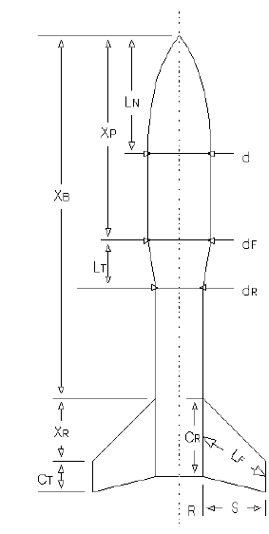
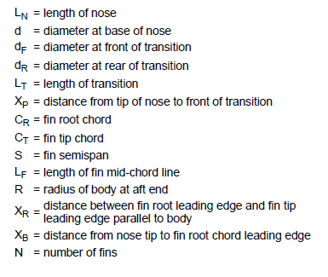
Parameters used in Calculating Model Rocket Aerodynamics
This approach assumes the straight body tube segmentss do not generate lift. This is a reasonable assumption since the angle of attack of a rocket is generally small.

Slide 51
Nose Normal Force Coefficient and CP Position
Normal Force Coefficient of Nose = (C_{N})_{N}
(C_{N})_{N} = 2.0 this value is a constant regardless of shape and size
0.666 L_{N}
X_{N} = 0.666 L_{N}
Ogive
L_{N} = Nose Length
X_{N} = 0.466 L_{N}
Conical
0.466 L_{N}

Slide 52
Transition Section Normal Force Coefficient and CP Position
Normal Force Coefficient of the Body Tube = (C_{N})_{T}
d_{R} 2 d_{F} 2
(C_{N})_{T} = 2 x -------- - --------
d d
Note: If your rocket does not have a transition section, then this parameter is not calculated…

Slide 53
Transition Section Normal Force Coefficient and CP Position
Location of Normal Force Coefficient of the Transition = X_{T}
d_{F}
1 - ---------
d_{R}
LT
X_{T} = X_{P} + -------- 1 + -------------------------------------
3
d_{F} 2
1 - ------------
d_{R}
Note: If your rocket does not have a transition section, then this parameter is not calculated…

Slide 54
Fin Normal Force Coefficient and CP Position
Normal Force Coefficient of the Body Tube = (C_{N})_{F}
S 2
4N ---------
d
R
(C_{N})_{F} = 1 + -------- x -------------------------------------
S + R
2 L_{F} 2
1 + 1 + --------------
C_{R} + C_{T}

Slide 55
Fin Normal Force Coefficient and CP Position
Location of Normal Force Coefficient of the Transition = X_{F}
X_{R} ( C_{R} + 2C_{T} ) 1 ( C_{R} x C_{T} )
X_{F} = X_{B} + ----------------------- + ----- (C_{R} + C_{T} ) - -------------------
3 ( C_{R} + C_{T} ) 6 ( C_{R} + C_{T} )

Slide 56
Calculating the total CP Position
Sum the Normal Force Coefficients:
(C_{N})_{R} = (C_{N})_{N} + (C_{N})_{T} + (C_{N})_{F}
Find the CP distance from the nose tip:
(C_{N})_{N} X_{N} + (C_{N})_{T} X_{T} + (C_{N})_{F} X_{F}
X_{CP} = ----------------------------------------------------
(C_{N})_{R}
These are essentially the “moments” resulting from the lift being generated by the three primary rocket components. We don’t have to go as far as calculating the lift since the associated terms simply cancel out.

Slide 57
Summary
The static margin is the distance between the CP and CG
The CG needs to be forward of the CP in order to have a stable rocket
Ideally the CG should be 2 body diameters in front of the CP
Fins at the back of the rocket will move the CP aft
Makes the rocket more stable
Larger fins tend to make the rocket more stable
But, larger fins create more drag, which leads to lower acceleration, which leads to lower altitude

Slide 58
Summary
Adding weight to the front of the rocket will move the CG forward
Makes the rocket more stable
But Newton says the rocket will not accelerate as well
Higher stability tends to make the rocket more wind sensitive

Slide 59
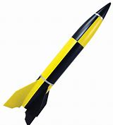
Questions?

